Slide 1

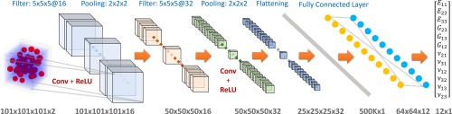
ARTIFICIAL INTELLIGENCE
ES 612
DEEP LEARNING
CONVOLUTION NETWORKS
https://www.sciencedirect.com/science/article/abs/pii/S0927025620303414

Slide 2
CONTENTS
Convolution
Motivation
Why CNN
What is CNN
Layers
Normalization
Back Propagation and Gradient Decent

Slide 3
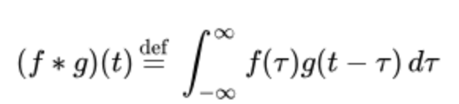
CONVOLUTION
Two signal produces a third signal
Sliding one signal over reflected, folded and shifted signal

Slide 4
MOTIVATION

Slide 5
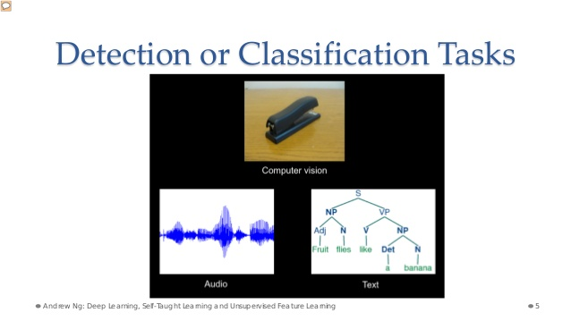
https://www.slideshare.net/GauravMittal68/convolutional-neural-networks-cnn

Slide 6
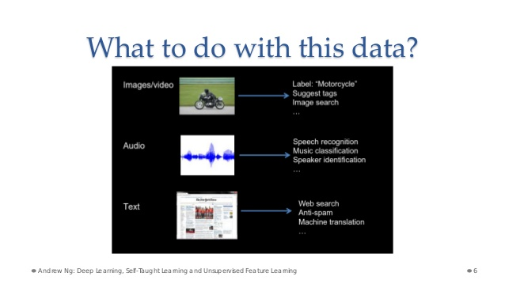
https://www.slideshare.net/GauravMittal68/convolutional-neural-networks-cnn

Slide 7
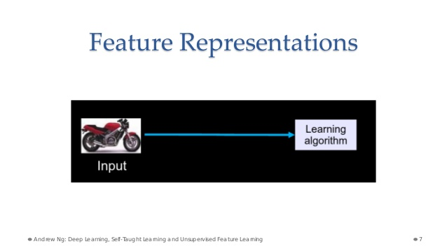
https://www.slideshare.net/GauravMittal68/convolutional-neural-networks-cnn

Slide 8
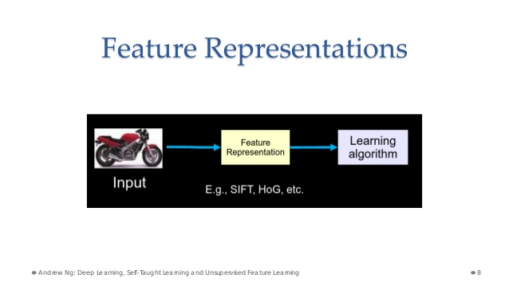
https://www.slideshare.net/GauravMittal68/convolutional-neural-networks-cnn

Slide 9
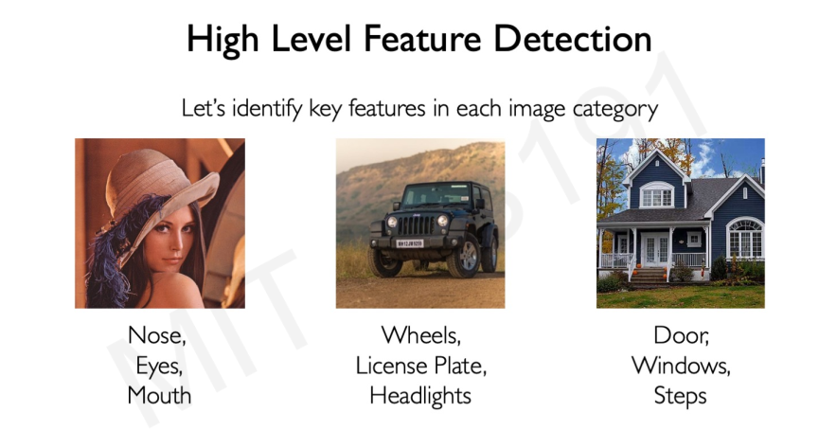
http://introtodeeplearning.com/slides/6S191_MIT_DeepLearning_L3.pdf

Slide 10
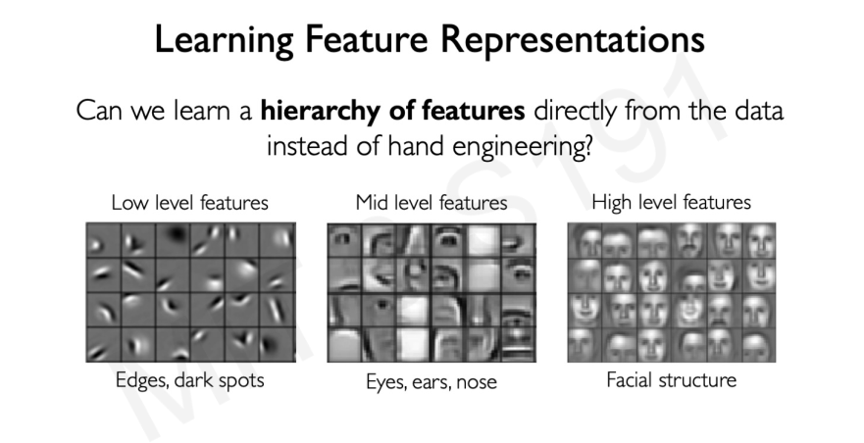
http://introtodeeplearning.com/slides/6S191_MIT_DeepLearning_L3.pdf

Slide 11
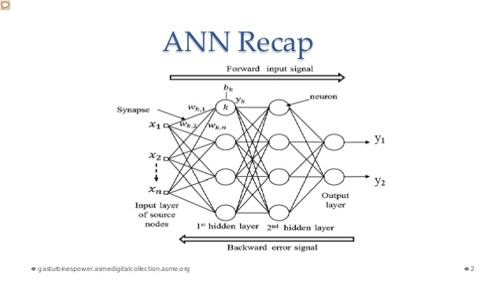
https://www.slideshare.net/GauravMittal68/convolutional-neural-networks-cnn

Slide 12
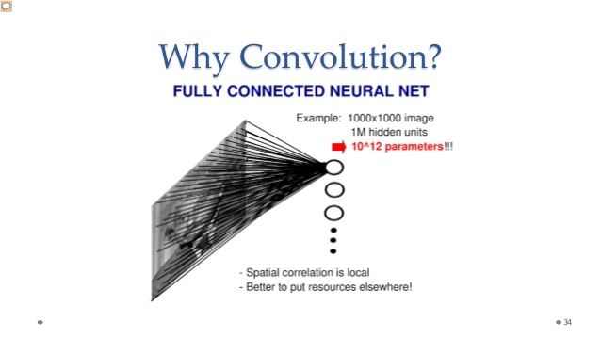
https://www.slideshare.net/GauravMittal68/convolutional-neural-networks-cnn

Slide 13
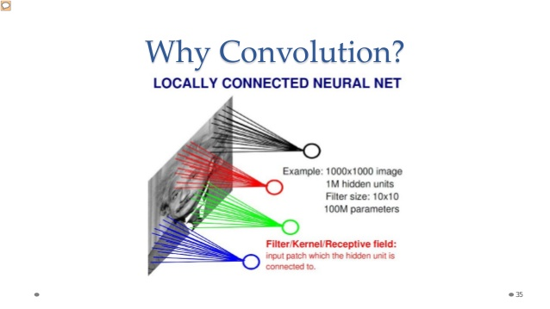
https://www.slideshare.net/GauravMittal68/convolutional-neural-networks-cnn

Slide 14
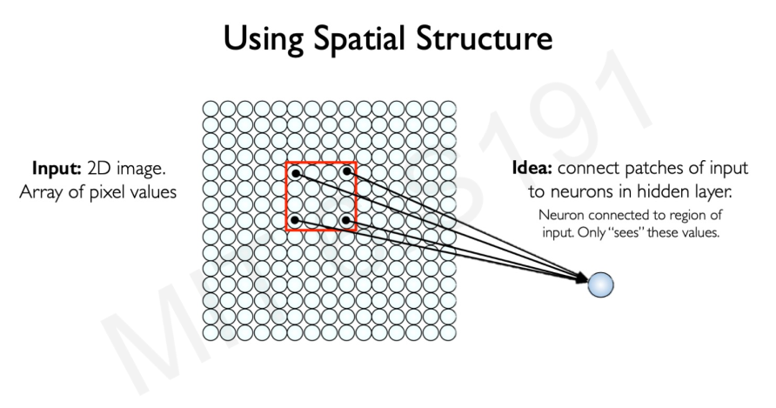
http://introtodeeplearning.com/slides/6S191_MIT_DeepLearning_L3.pdf

Slide 15
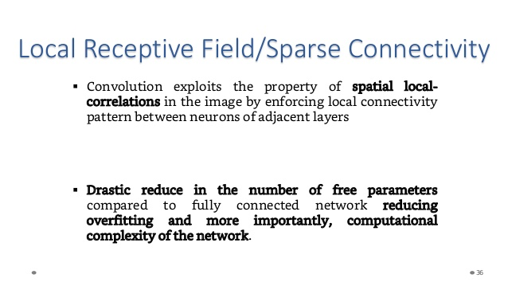
https://www.slideshare.net/GauravMittal68/convolutional-neural-networks-cnn

Slide 16
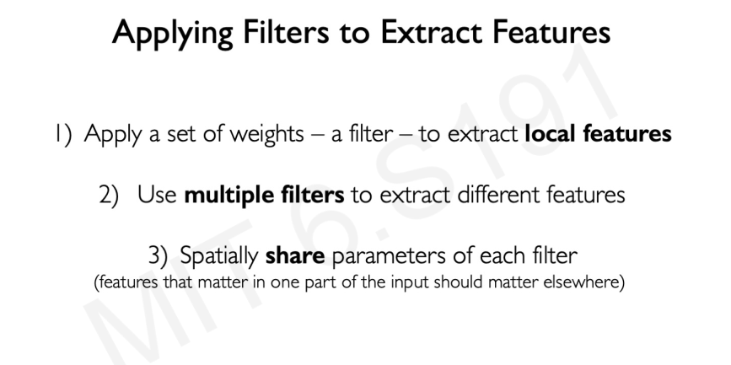
http://introtodeeplearning.com/slides/6S191_MIT_DeepLearning_L3.pdf

Slide 17
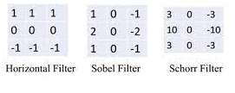
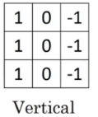
MULTIPLE FILTERS
https://www.google.com/search?q=cnn+filters+types&tbm=isch&ved=2ahUKEwitgMTLl-nvAhUIYRoKHTEkA5oQ2-cCegQIABAA&oq=cnn+filters&gs_lcp=CgNpbWcQARgBMgIIADICCAAyAggAMgYIABAFEB4yBAgAEBgyBAgAEBg6BAgjECc6BAgAEEM6BggAEAgQHlDAtwNYjsoDYNjcA2gAcAB4AIABqQaIAYoekgELMi02LjMuMS4wLjGYAQCgAQGqAQtnd3Mtd2l6LWltZ8ABAQ&sclient=img&ei=lhlsYK3dH4jCabHIjNAJ&bih=600&biw=1349&rlz=1C1CHBF_en__814__814&hl=en

Slide 18
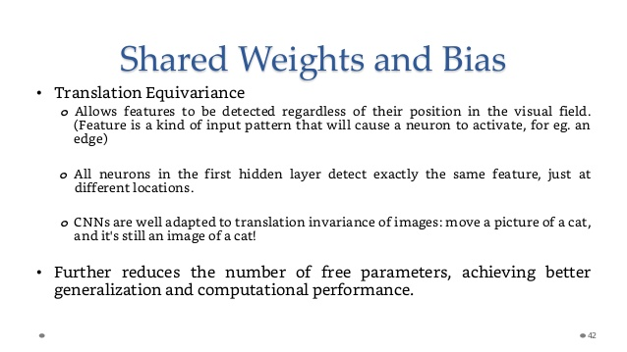
https://www.slideshare.net/GauravMittal68/convolutional-neural-networks-cnn

Slide 19
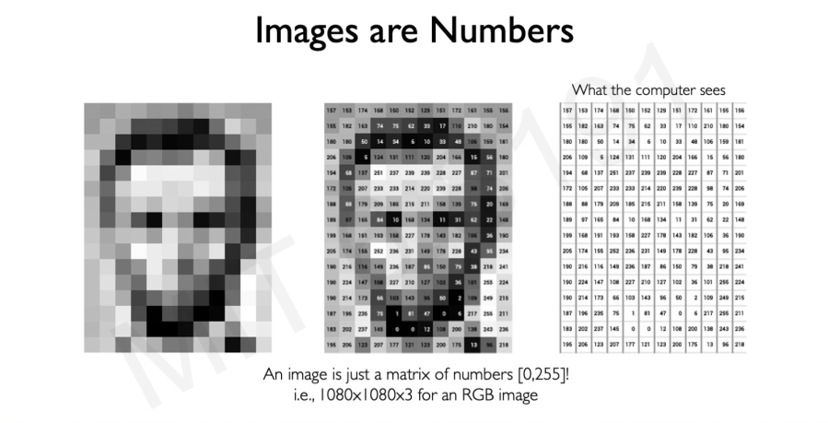
http://introtodeeplearning.com/slides/6S191_MIT_DeepLearning_L3.pdf

Slide 20
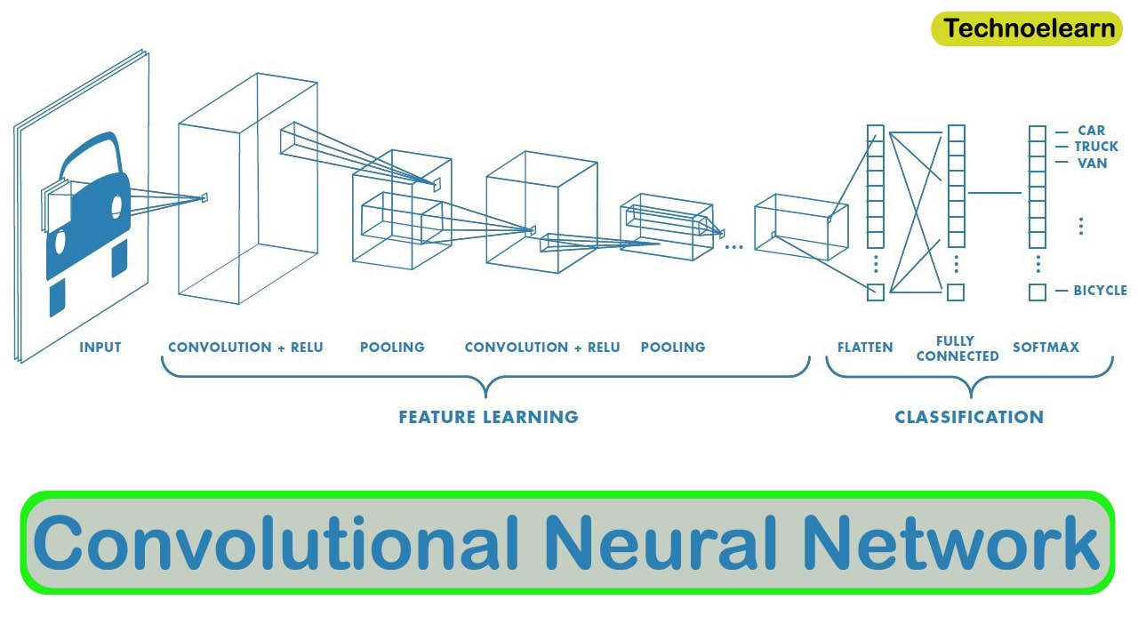
https://www.google.com/search?q=local+spatial+invariance&newwindow=1&rlz=1C1CHBF_en__814__814&sxsrf=ALeKk01JG9cLuigRFnhf0J06s8sAOzDjvg:1617695589676&source=lnms&tbm=isch&sa=X&ved=2ahUKEwirjOjXkenvAhW88rsIHSj4CJ8Q_AUoAXoECAIQAw&biw=1366&bih=657#imgrc=3dlBf039HpfOzM

Slide 21
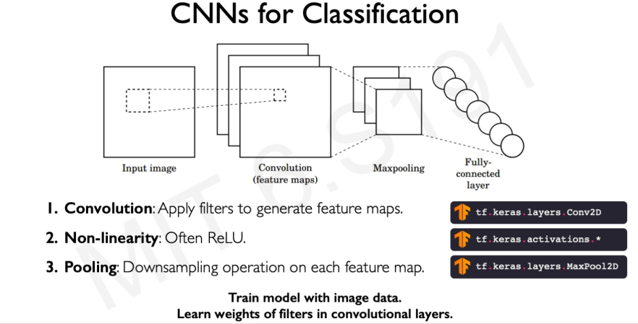
4. Fully Connected Layer: To determine the output
http://introtodeeplearning.com/slides/6S191_MIT_DeepLearning_L3.pdf

Slide 22
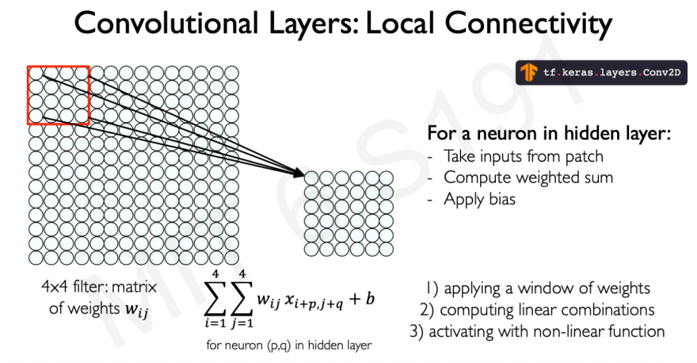
http://introtodeeplearning.com/slides/6S191_MIT_DeepLearning_L3.pdf

Slide 23
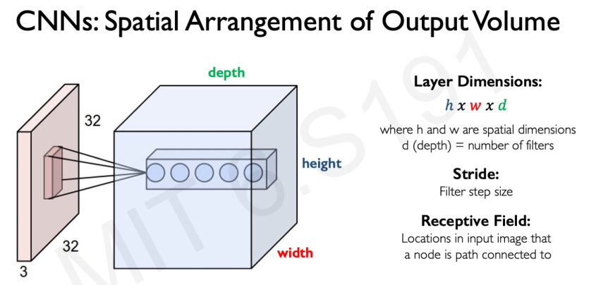
http://introtodeeplearning.com/slides/6S191_MIT_DeepLearning_L3.pdf

Slide 24
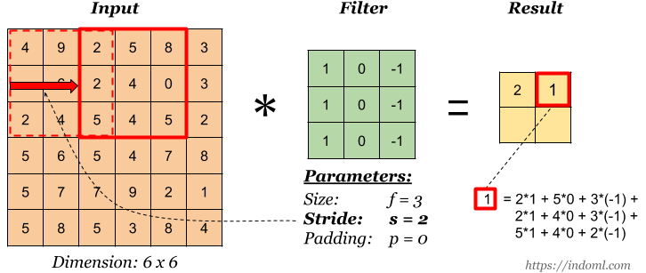
https://www.google.com/search?q=striding+in+cnn&newwindow=1&rlz=1C1CHBF_en__814__814&sxsrf=ALeKk02eD-Ytg5G9uoz46wJ-QQyysoC07Q:1617701353675&source=lnms&tbm=isch&sa=X&ved=2ahUKEwiYh6eUp-nvAhXQYMAKHVpkB00Q_AUoAXoECAEQAw&biw=1366&bih=657#imgrc=SMIP8e0Gg8wo-M

Slide 25
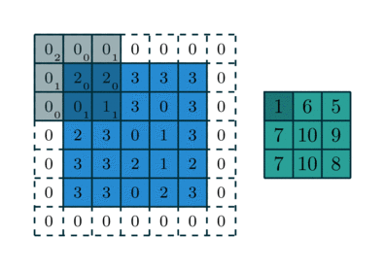
PADDING
https://www.google.com/search?q=PADDING+IN+CNN&tbm=isch&ved=2ahUKEwiM46vzqenvAhVF-RQKHVdGDJwQ2-cCegQIABAA&oq=PADDING+IN+CNN&gs_lcp=CgNpbWcQAzICCAAyBggAEAUQHjIGCAAQBRAeMgYIABAIEB4yBAgAEBgyBAgAEBg6BggAEAoQGFCB6wZY9pQHYNOeB2gBcAB4AYAB0QiIAe8ykgENMi00LjEuMi4xLjMuMZgBAKABAaoBC2d3cy13aXotaW1nwAEB&sclient=img&ei=ySxsYMzaM8XyU9eMseAJ&bih=657&biw=1366&rlz=1C1CHBF_en__814__814#imgrc=TAraETo8TW_gSM

Slide 26
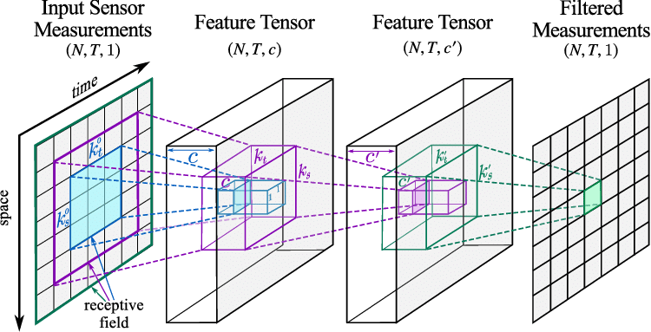
Tensors
https://www.google.com/search?q=Tensor+in+CNN&tbm=isch&ved=2ahUKEwirq_uxrOnvAhXS2-AKHUqWDtIQ2-cCegQIABAA&oq=Tensor+in+CNN&gs_lcp=CgNpbWcQAzIECAAQGDoECAAQQzoCCAA6BggAEAgQHjoGCAAQBRAeULaQFVi7ohVglqsVaABwAHgAgAGJBYgBiBySAQkyLTEuMy4xLjOYAQCgAQGqAQtnd3Mtd2l6LWltZ8ABAQ&sclient=img&ei=Zi9sYKvgAtK3gwfKrLqQDQ&bih=657&biw=1366&rlz=1C1CHBF_en__814__814#imgrc=8WMObPBwMAQ-eM

Slide 27
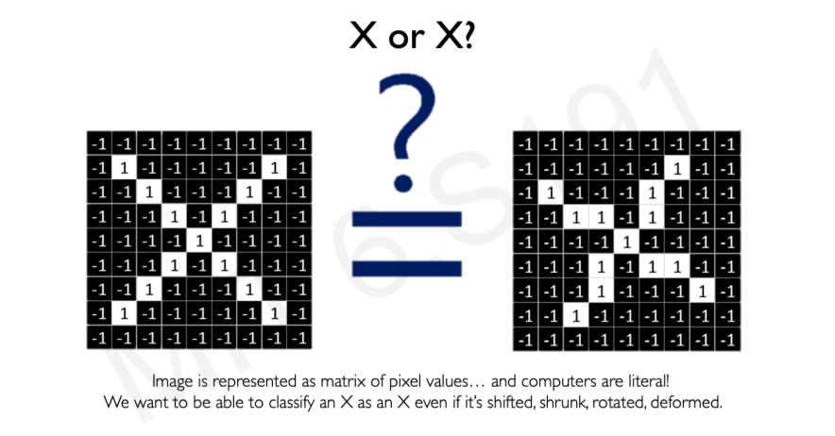
http://introtodeeplearning.com/slides/6S191_MIT_DeepLearning_L3.pdf

Slide 28
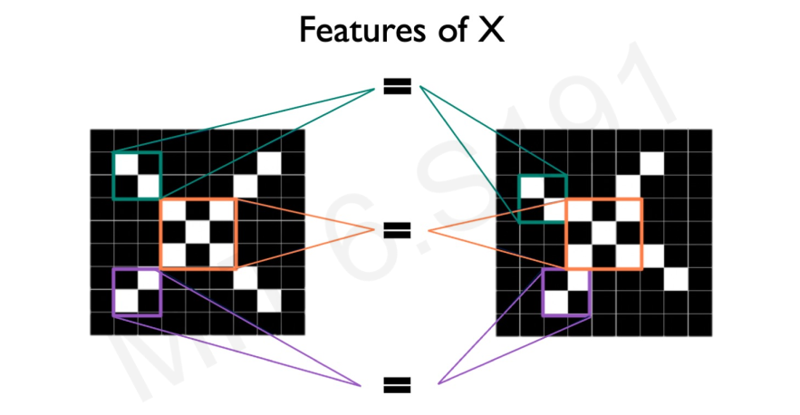
http://introtodeeplearning.com/slides/6S191_MIT_DeepLearning_L3.pdf

Slide 29
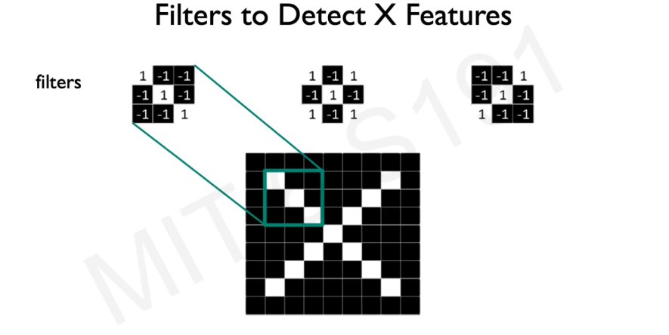
http://introtodeeplearning.com/slides/6S191_MIT_DeepLearning_L3.pdf

Slide 30
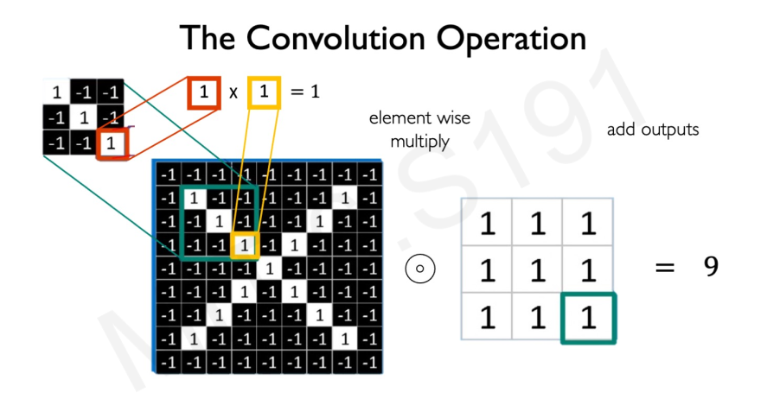
http://introtodeeplearning.com/slides/6S191_MIT_DeepLearning_L3.pdf

Slide 31
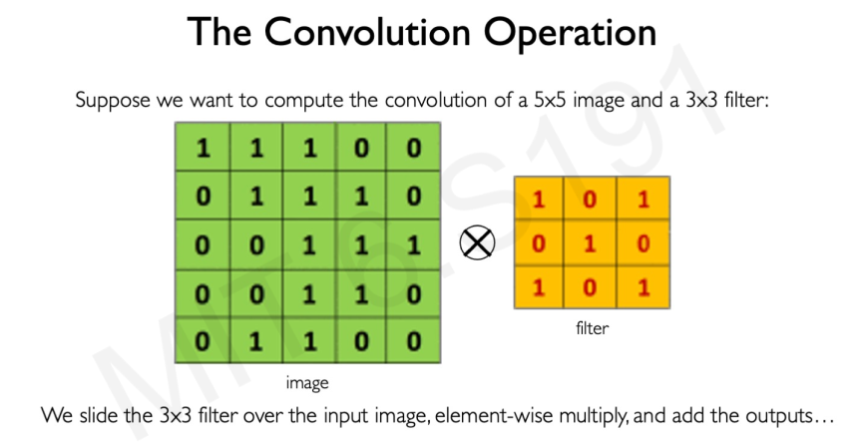
http://introtodeeplearning.com/slides/6S191_MIT_DeepLearning_L3.pdf

Slide 32
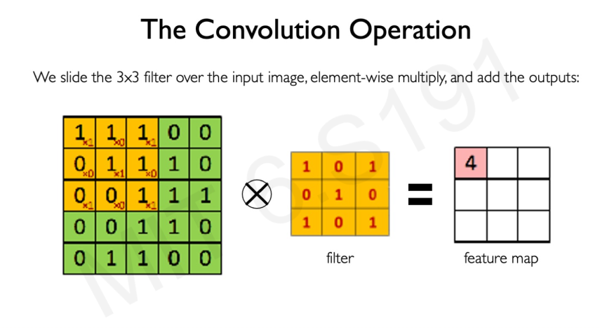
http://introtodeeplearning.com/slides/6S191_MIT_DeepLearning_L3.pdf

Slide 33
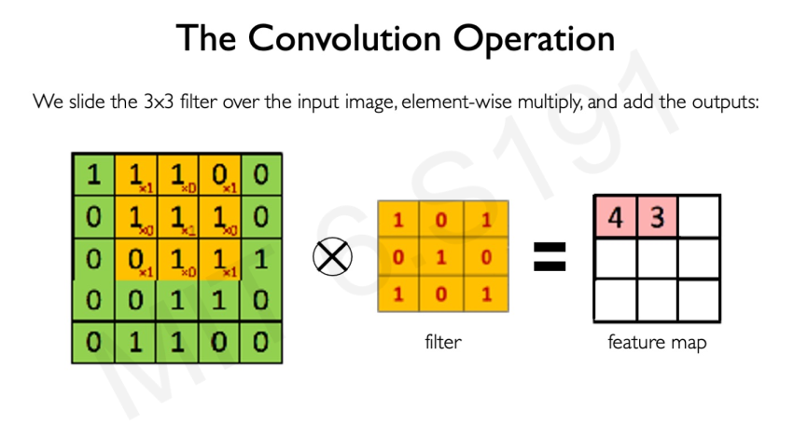
http://introtodeeplearning.com/slides/6S191_MIT_DeepLearning_L3.pdf

Slide 34
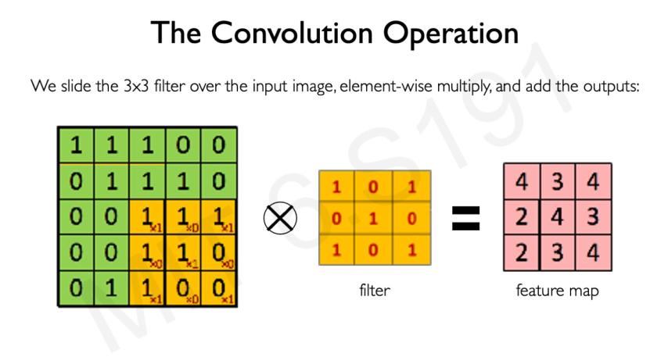
http://introtodeeplearning.com/slides/6S191_MIT_DeepLearning_L3.pdf

Slide 35
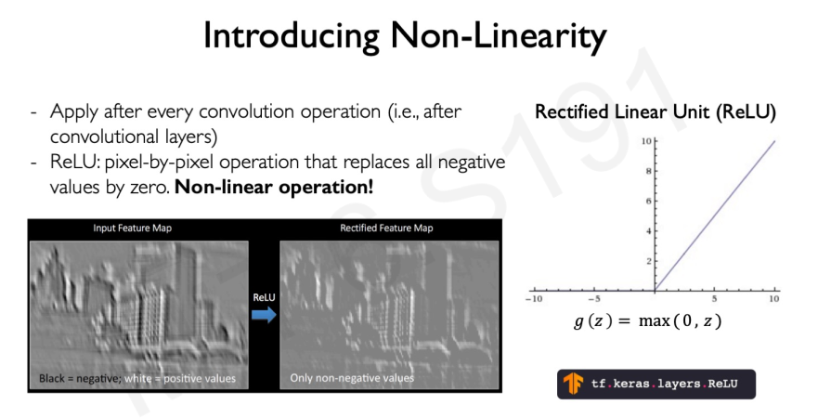
http://introtodeeplearning.com/slides/6S191_MIT_DeepLearning_L3.pdf

Slide 36
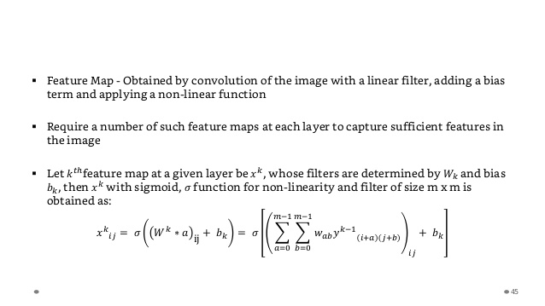
https://www.slideshare.net/GauravMittal68/convolutional-neural-networks-cnn

Slide 37
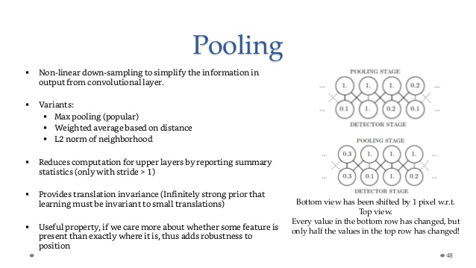
https://www.slideshare.net/GauravMittal68/convolutional-neural-networks-cnn

Slide 38
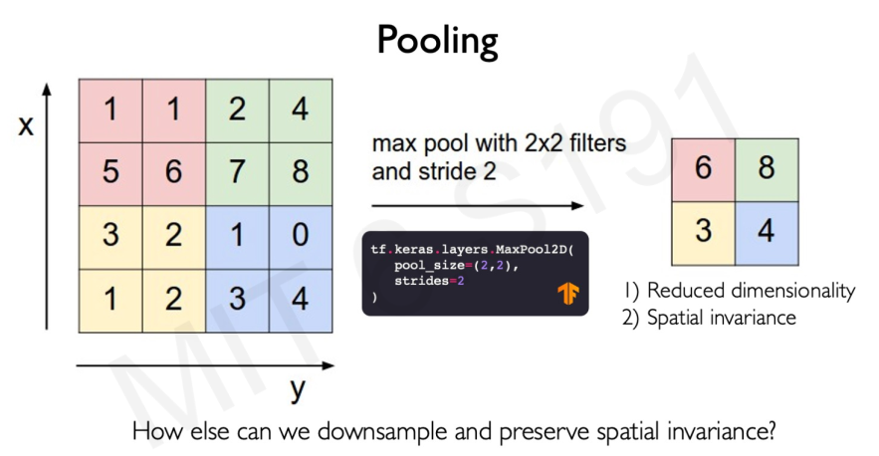
http://introtodeeplearning.com/slides/6S191_MIT_DeepLearning_L3.pdf

Slide 39
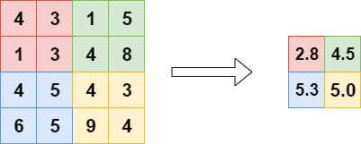
AVERAGE POOLING
https://www.google.com/search?q=average+pooling&tbm=isch&ved=2ahUKEwiFxJ2Yp-nvAhUN04UKHdJNCzAQ2-cCegQIABAA&oq=Averge+pooling&gs_lcp=CgNpbWcQARgAMgYIABAKEBg6AggAOgQIABBDOgQIABAKULX3K1iZlSxgwZ4saABwAHgAgAHdA4gBtyGSAQgyLTEwLjEuM5gBAKABAaoBC2d3cy13aXotaW1nwAEB&sclient=img&ei=8SlsYMWHN42mlwTSm62AAw&bih=657&biw=1366&rlz=1C1CHBF_en__814__814#imgrc=ROCJXYJDdno4hM

Slide 40
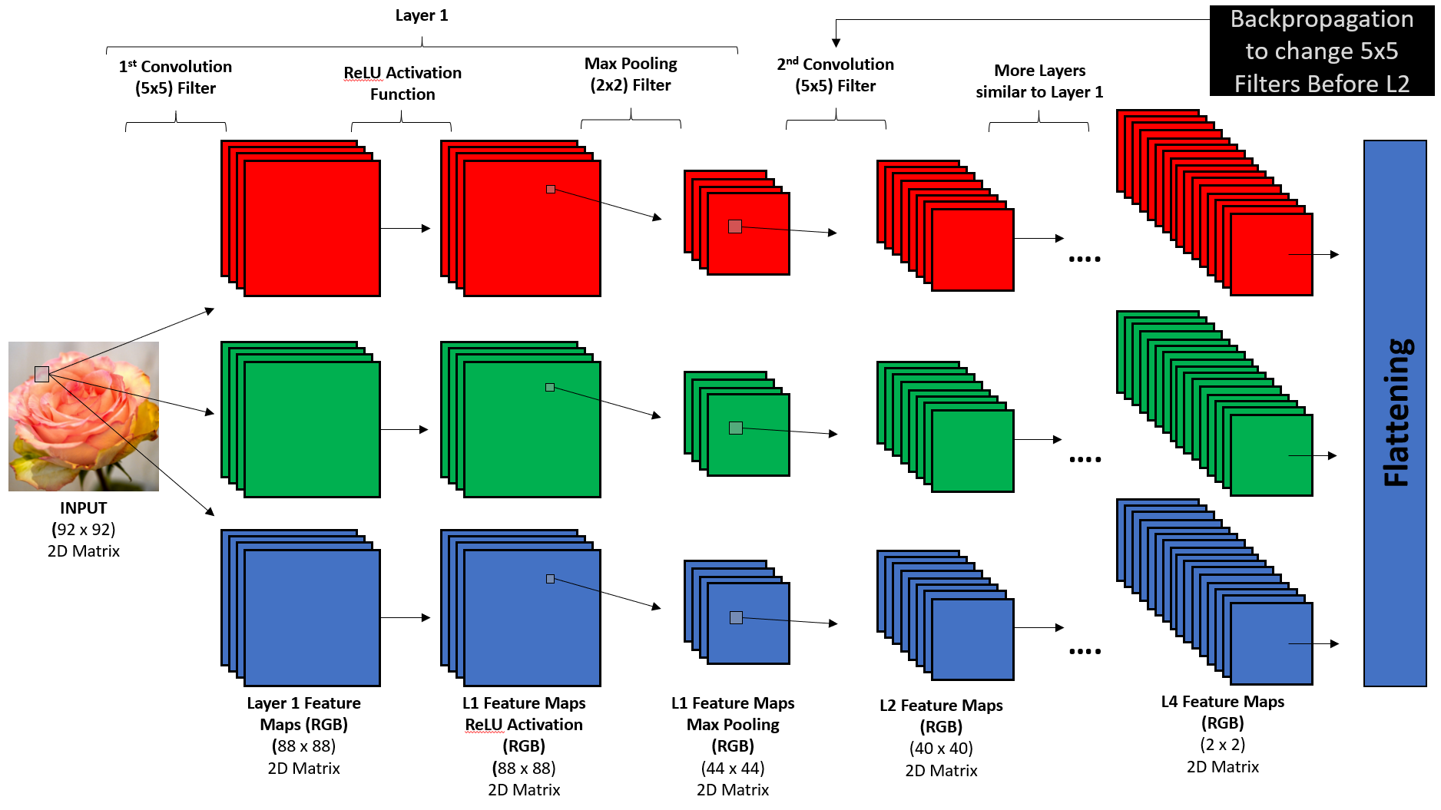
RGB IMAGE

Slide 41
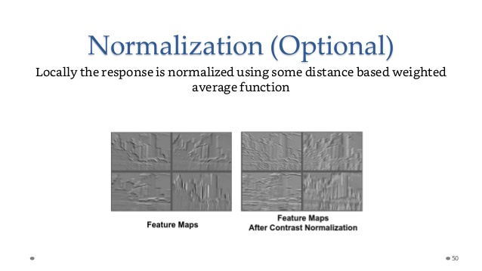
https://www.slideshare.net/GauravMittal68/convolutional-neural-networks-cnn

Slide 42
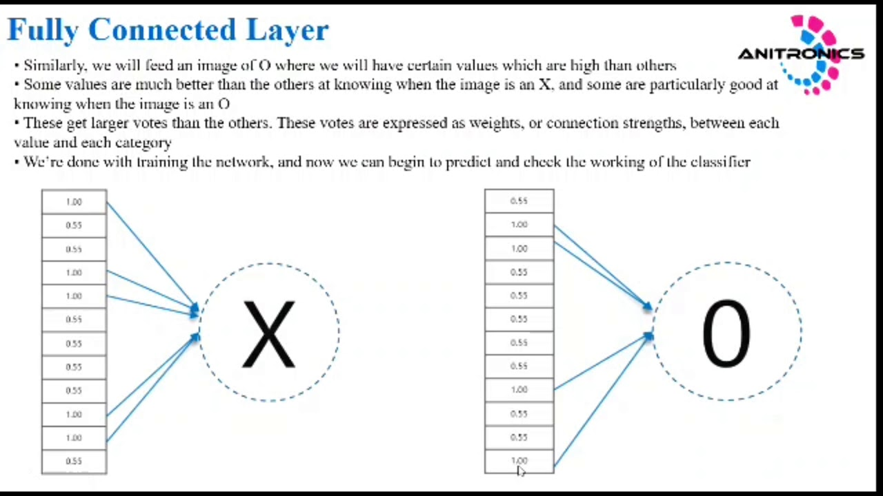
https://www.google.com/search?q=fully+connected+layer+in+cnn&tbm=isch&ved=2ahUKEwjJ642Kq-nvAhURohoKHaTlB9MQ2-cCegQIABAA&oq=fully+connected+layer+in+cnn&gs_lcp=CgNpbWcQARgAMgIIADIECAAQGDIECAAQGDIECAAQGDoECAAQQ1Cd8BRYnZkVYMehFWgAcAB4AYAB7wWIAaU3kgEMMi0xOC40LjAuMS4xmAEAoAEBqgELZ3dzLXdpei1pbWfAAQE&sclient=img&ei=Bi5sYMnQAZHEaqTLn5gN&bih=657&biw=1366&rlz=1C1CHBF_en__814__814#imgrc=Quh74C7j01LFuM

Slide 43
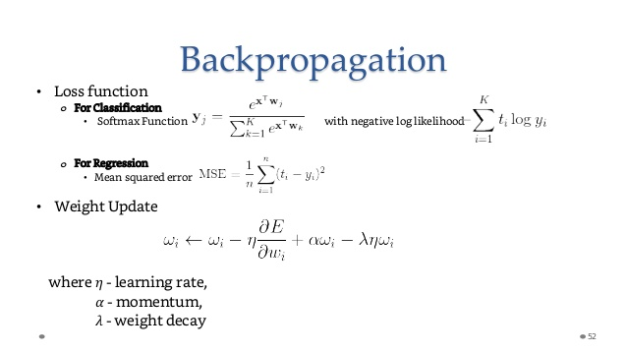
https://www.slideshare.net/GauravMittal68/convolutional-neural-networks-cnn

Slide 44
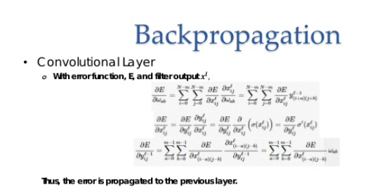
https://www.slideshare.net/GauravMittal68/convolutional-neural-networks-cnn

Slide 45
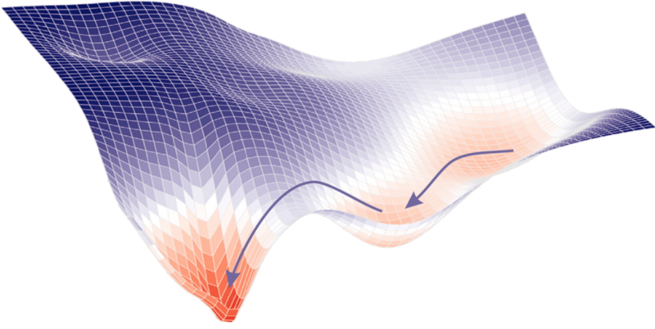
GRADIENT DECENT

